Slide 1
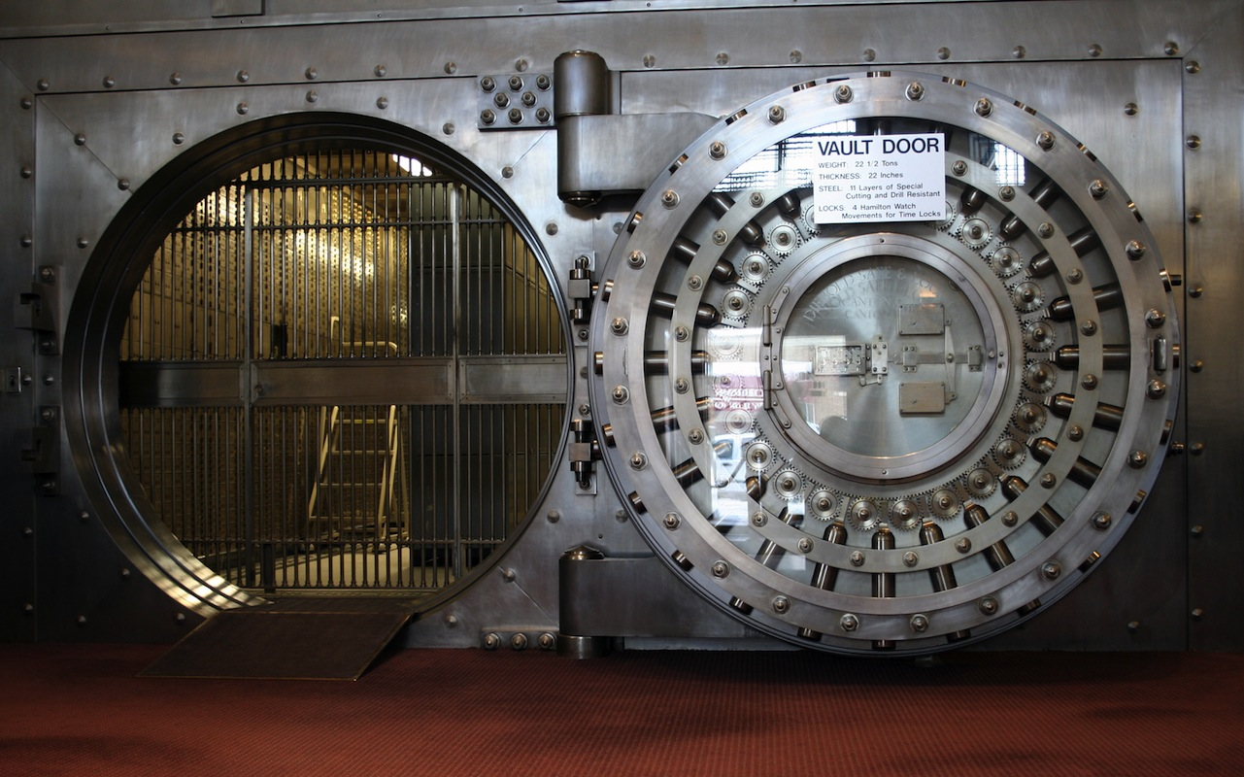
OCEANS 15
Bank heist adventure game by team 15

Slide 2
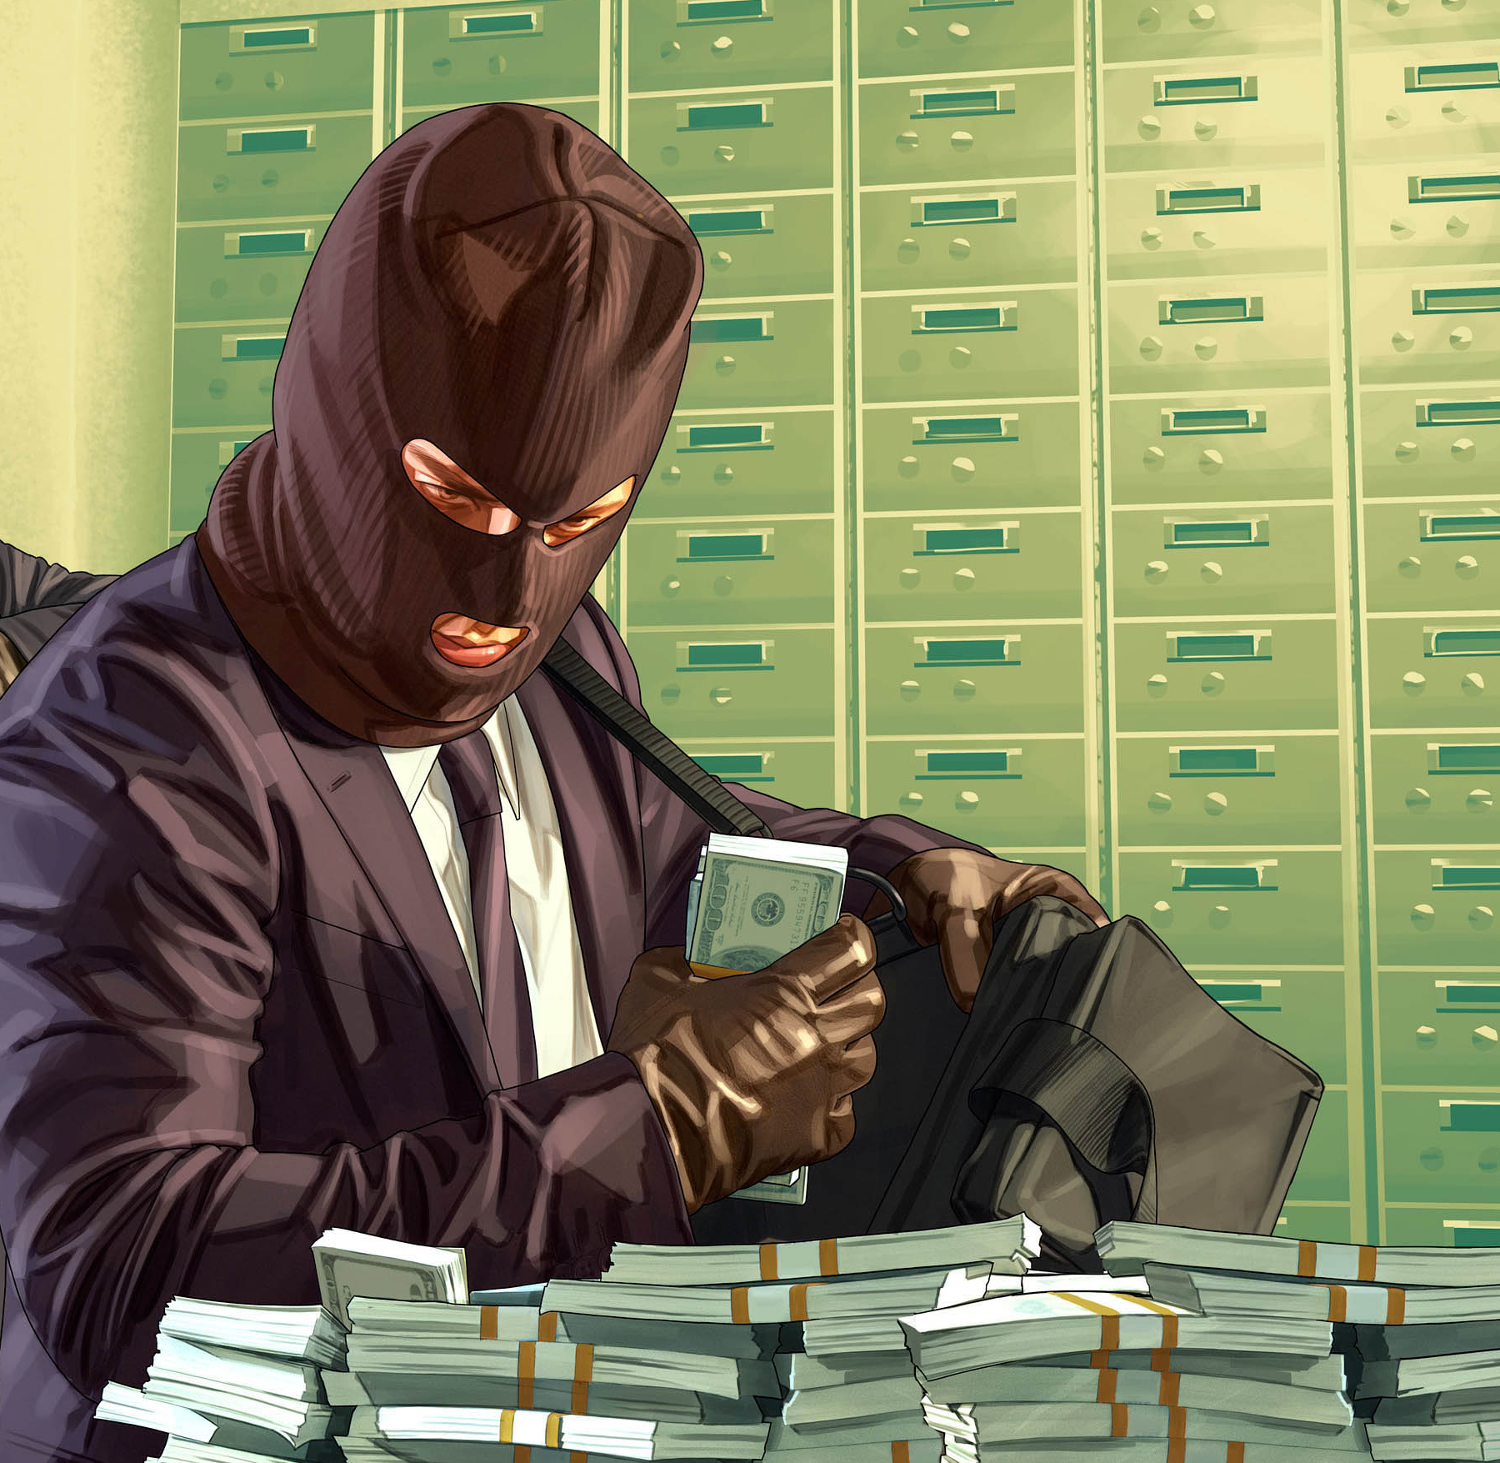
The Story
The character played by the user is an ordinary man, with honest motives
but questionable morals, that has agreed to take part in a bank heist.
The realistic backstory and description of the main character plays a large part in this game, giving each move and decision a purpose.
Your goal is to make a series of decisions that will affect your outcome, and manoeuvre through the bank towards the vault, in which you’ll find the riches you desire.
There are many options available to the user, giving a large amount of content for the user to explore and thus entertain them for extended periods of time
Using a mixture of items the player has purchased during the pre-planning phase, minor decisions made throughout, and various items found scattered throughout the bank, the character must find a way to complete the tasks and final goal efficiently.
Interesting rules that measure the character’s level of suspicion will effect the outcome of the game. This creates a dynamic storyline as there are many different paths that the user can follow and thus various endings.

Slide 3

Defining Features
While text-based games all follow a similar format, this game has some defining features that make it stand out:
Turn based: Each action carried out by the user is counted, and a leader board in a database created by SQL will contain the user’s name, with users who have completed the game in less turns closer to the top.
Scaled Victory: Assuming that you have completed the main objective within the set number of turns, the amount of turns you have left at the end will determine your rank on the leader board
Measure of suspicious activity: The amount of suspicious acts the character performs will be closely related to the user’s ability to reach their goal. i.e. after exceeding a certain threshold, the user will be caught and sent back to a previous checkpoint.
Side-tasks: A series of small-scale tasks that the user must perform in order to gain access to the vault and finish the game
Non-linear story line: many different factors can contribute to the ending that is provided to the user. This ensures that they remain entertained after playing the game multiple times, and adds a dynamic and unique depth that the game would not otherwise have.
Leader board: the user’s score (depending on how efficiently they achieved their goal) will be displayed and compared to other user’s scores.
pre game: An element of the game worth noting is the ‘pre-game’ phase, in which the user can make a series of decisions and purchases that can either benefit or work against them once the main game begins.
Save game function: A very important feature on this game which allows the user to save at any point to later load.
Suspicion/stealth: This in built feature makes for a more challenging game as the user will have to manoeuvre around the map without making much noise, anything from trying to open a door to punching a guard in the face will increase your suspicion meter until you get caught.

Slide 4
Justification of design decisions
Layout
ASCII art
Character iteration to display the story to the user
Architecture:
Modules
Procedural paradigm
SQL Database
Command Architecture

Slide 5

Why should you choose this game?
If you are looking for a game with an exciting story, with the freedom to affect the outcome depending on your personal decisions, then this is the game for you!
Ocean’s 15 takes the stereotypical text-based adventure game format, but spices it up with the use of a modern, and somewhat realistic setting, alongside characters you can empathise with, and situations that you trigger by your own actions.
Ocean’s 15 tackles the traditional text-based adventure game from a different angle, engaging the user in various different sub-tasks.
What sets this game is that various functions (e.g. suspicion levels, number of turns, etc.) work in harmony to mimic real life as closely as possible; this is an extremely effective approach as logic is highly beneficial when playing.
Do you think you could carry out a successful bank heist? The only way to find out is to try this game!

